Slide 1

Simple to Use
Stable Platform
Outstanding Customer Service

Slide 2

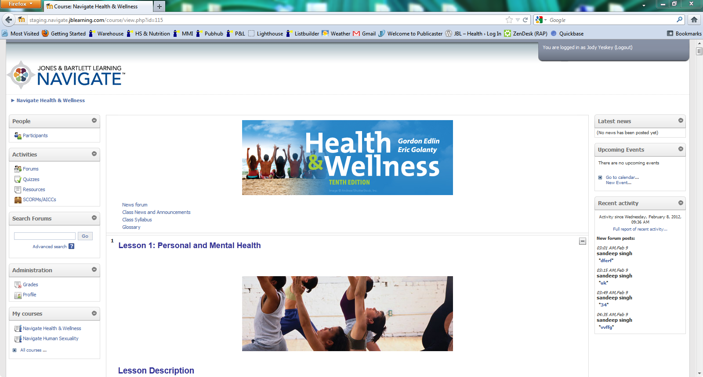
Navigate seamlessly combines authoritative textbook content with interactive activities, outcomes-based assessments, and robust reporting tools that enable instructors to track real-time student progress.

Slide 3


Instructor Features

Slide 4
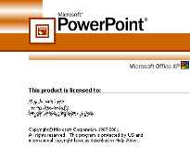



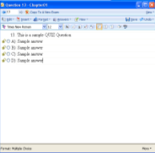


Content is
pre-populated
in the course
for immediate
use

Slide 5
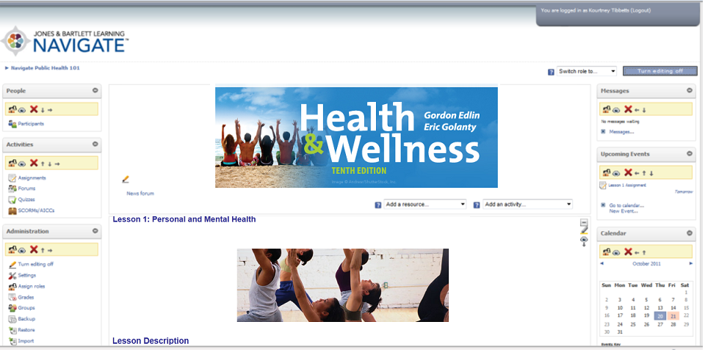
Easy Access to Editing
One Click Editing
Icon Driven Tools

Slide 6
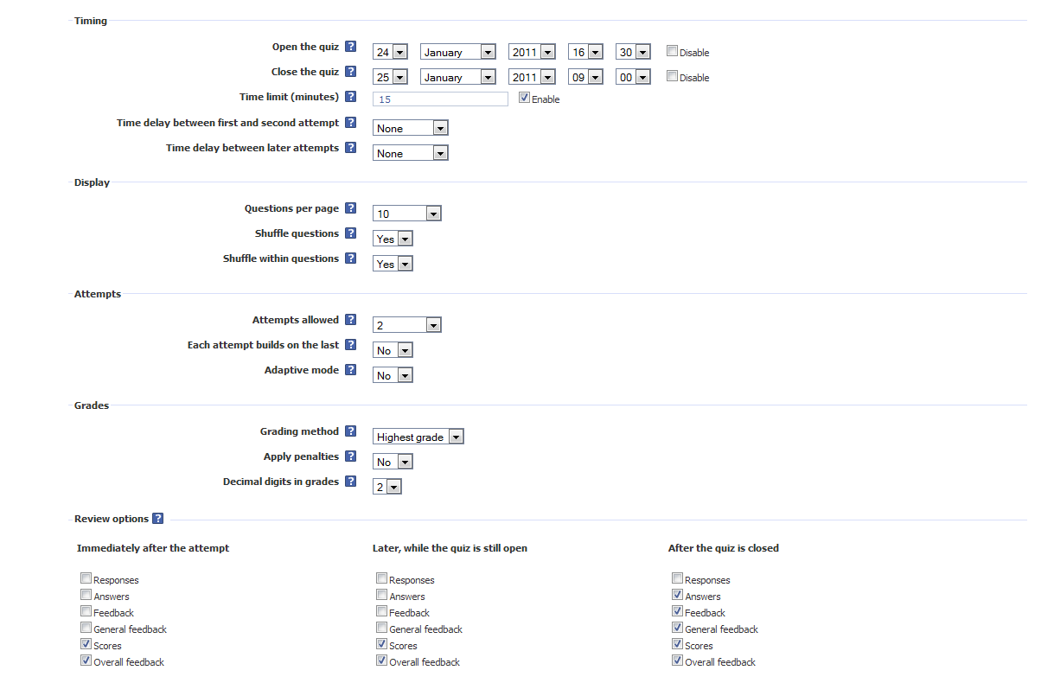
User-friendly control panel lets you deploy & track online quizzes & homework

Slide 7
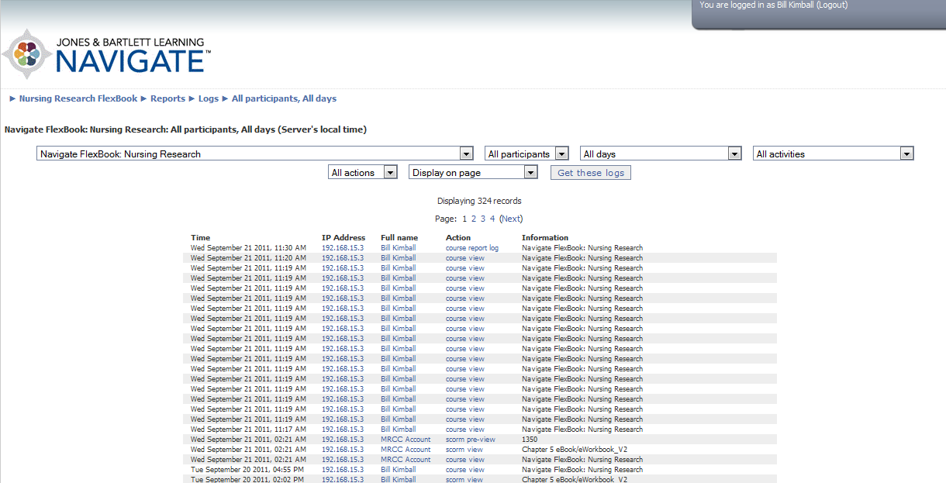
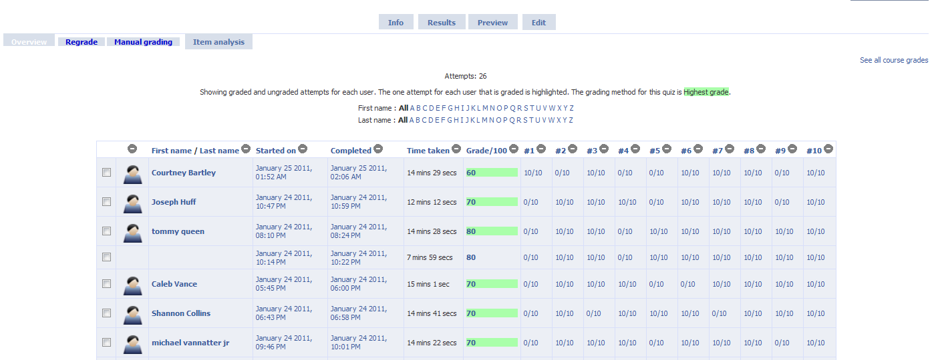
Robust Grade Book Functionality
Detailed reporting on students’ progress and overall class statistics

Slide 8
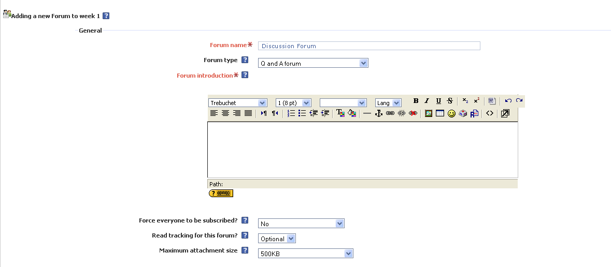
Collaboration tools include discussion forums, blog, chat, single question polling and WIKI functionality

Slide 9

Upload Your Own Content & Embed Video

Slide 10


Student Features

Slide 11
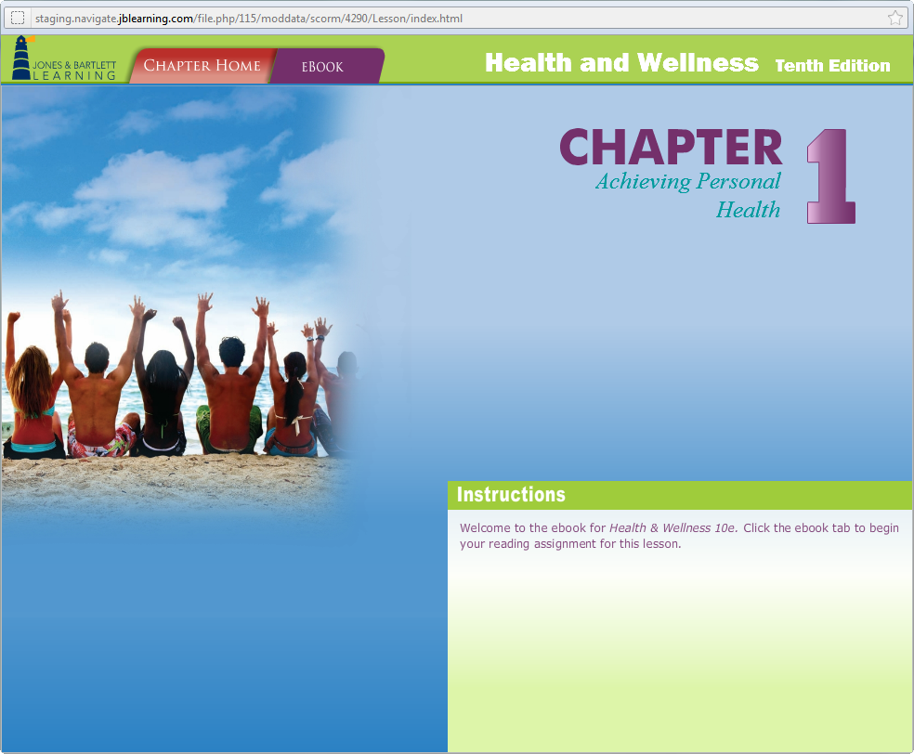
Integrated eBook
Students
can access the text anytime, anywhere!

Slide 12
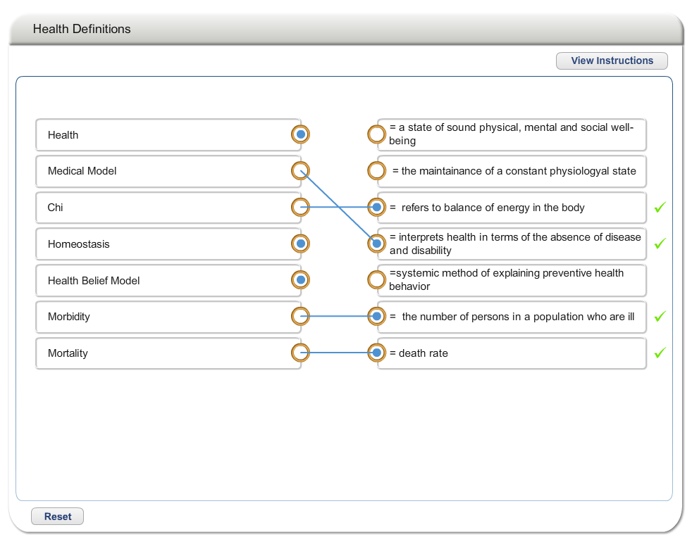
Interactive Activities
Aid student comprehension and retention with drag and drop, matching, and labeling exercises.

Slide 13
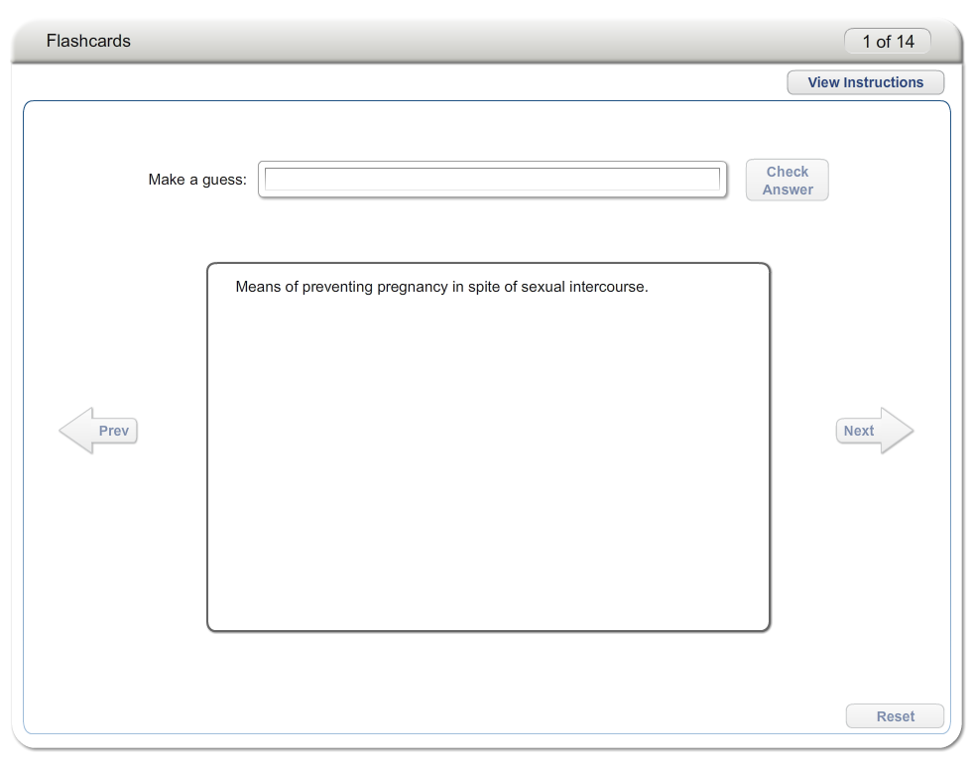
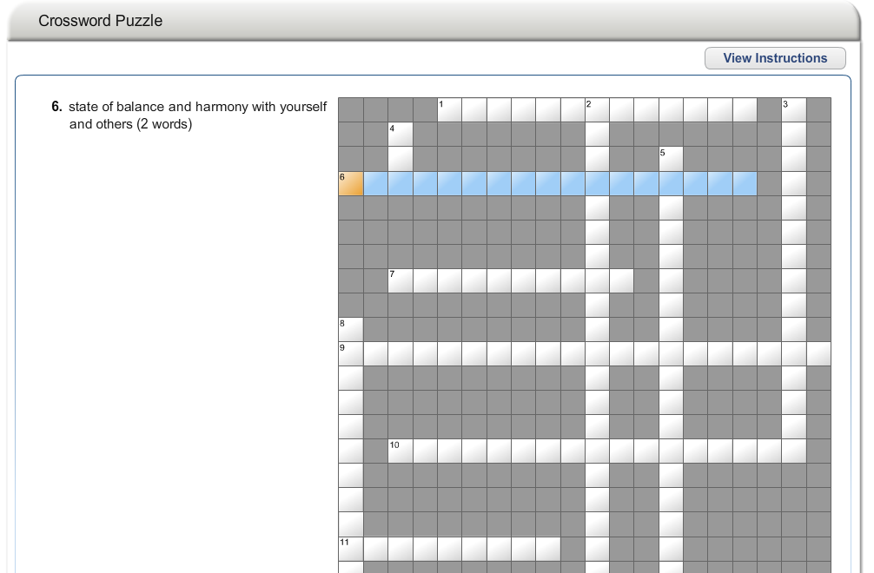
Pre-Loaded Exercises
Crossword Puzzles, Flashcards,
Study Questions, and more help students review important concepts and terms from the textbook.

Slide 14
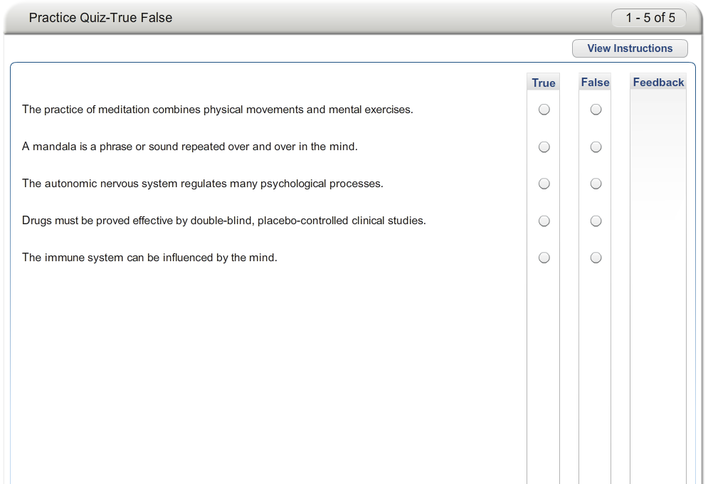
Practice Quizzes
Practice quizzes are graded
as complete or incomplete.

Slide 15

Technical Support
Includes web hosting and technical support—no need to involve your IT Department!
FREE for students & instructors
U.S. Based Support
Available via web, phone, or email
Complete systems training is available to adopting instructors.

