Slide 1
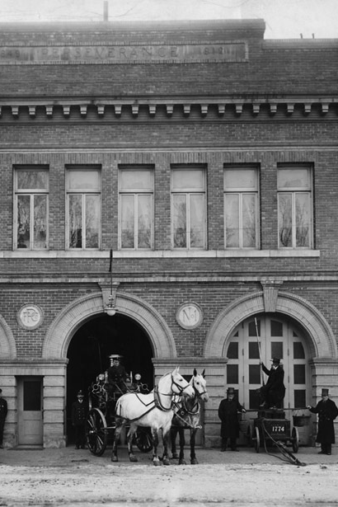
CHAPTER 1
The Orientation and History of the Fire Service

Slide 2
Fire Fighter I Objectives
List five guidelines for successful fire fighter training.
Describe the general requirements for becoming a fire fighter.
Outline the roles and responsibilities of a Fire Fighter I.
Describe the common positions of fire fighters within the fire department.

Slide 3
Fire Fighter I Objectives
Describe the specialized response roles within the fire department.
Explain the concept of governance and describe how the fire department’s regulations, policies, and standard operating procedures affect it.

Slide 4
Fire Fighter I Objectives
Locate information in departmental documents and standard operating procedures.
List the different types of fire department companies and describe their functions.
Describe how to organize a fire department in terms of staffing, function, and geography.

Slide 5
Fire Fighter I Objectives
Explain the basic structure of the chain of command within the fire department.
Define the four basic management principles used to maintain organization within the fire department.
Explain the evolution of the methods and tools of firefighting from colonial days to the present.

Slide 6
Fire Fighter I Objectives
Explain how building codes prevent the loss of life and property.
Describe the evolution of funding for fire department services.

Slide 7
Fire Fighter II Objectives
Outline the responsibilities of a Fire Fighter II.
Describe the roles of a Fire Fighter II within the fire department.

Slide 8
Introduction
Training to become a fire fighter is not easy.
Fire fighters are challenged both physically and mentally.
Fire fighter training will expand your understanding of fire suppression.

Slide 9
Fire Fighter Guidelines
Be safe.
Follow orders.
Work as a team.
Think!
Follow the Golden Rule.

Slide 10
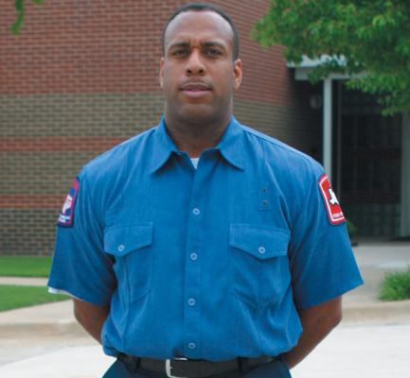
Fire Fighter Qualifications
Age requirements
Most departments require that candidates be between the ages of 18 and 21 years.
Education requirements
Most departments require a minimum of a high school diploma or equivalent.

Slide 11
Fire Fighter Qualifications
Medical requirements
Medical evaluations are often required before training can begin.
Medical requirements for fire fighters are specified in NFPA 1582, Standard on Comprehensive Operational Medical Program for Fire Departments.

Slide 12
Fire Fighter Qualifications
Physical fitness requirements
Physical fitness requirements ensure that fire fighters have the strength and stamina needed.
Emergency medical requirements
Departments may require fire fighters to be certified as an Emergency Medical Responder, Emergency Medical Technician (EMT)–Basic, or Paramedic.

Slide 13
Roles and Responsibilities for Fire Fighter I
Properly don and doff PPE.
Hoist hand tools using appropriate ropes and knots.
Understand and correctly apply appropriate communication protocols.
Use self-contained breathing apparatus (SCBA).

Slide 14
Roles and Responsibilities for Fire Fighter I
Respond on apparatus to an emergency.
Establish and operate safely in emergency work areas.
Force entry into a structure.
Exit a hazardous area safely as a team.
Set up ground ladders safely and correctly.

Slide 15
Roles and Responsibilities for Fire Fighter I
Attack a passenger vehicle fire, an exterior Class A fire, and an interior structure fire.
Conduct search and rescue in a structure.
Perform ventilation of an involved structure.
Overhaul a fire scene.

Slide 16
Roles and Responsibilities for Fire Fighter I
Conserve property with salvage tools.
Connect an engine to a water supply.
Extinguish Class A, Class B, Class C, and Class D fires.
Illuminate an emergency scene.
Turn off utilities.

Slide 17
Roles and Responsibilities for Fire Fighter I
Combat a ground cover fire.
Perform fire safety surveys.
Clean and maintain equipment.
Notes:
17

Slide 18
Roles and Responsibilities for Fire Fighter II
Prepare reports.
Communicate the need for assistance.
Coordinate an interior attack line team.
Extinguish an ignitable liquid fire.
Control a flammable gas cylinder fire.

Slide 19
Roles and Responsibilities for Fire Fighter II
Protect evidence of fire cause and origin.
Assess and disentangle victims from motor vehicle collisions.
Assist special rescue team operations.
Perform a fire safety survey.

Slide 20
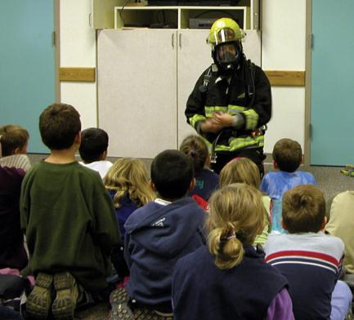
Roles and Responsibilities for Fire Fighter II
Present fire safety information.
Maintain fire equipment.
Perform annual service tests on fire hose.
<Insert Figure 1-3>

Slide 21
General Roles Within the Department
Fire apparatus driver/operator
Company officer
Safety officer
Training officer
Incident commander
Fire marshal/inspector/investigator

Slide 22
General Roles Within the Department
Fire and life safety education specialist
911 dispatcher/telecommunicator
Apparatus maintenance personnel
Fire police
Information management
Public information officer
Fire protection engineer

Slide 23
Specialized Response Roles
Aircraft/crash rescue fire fighter
Hazardous materials technician
Technical rescue technician
SCUBA dive rescue technician
Emergency Medical Services (EMS) personnel
EMT, Advanced EMT, and Paramedic

Slide 24
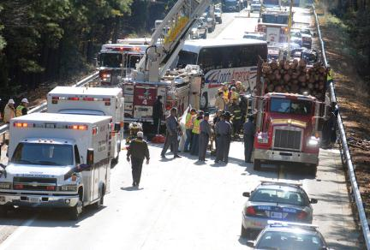
Working with Other Organizations
Fire departments need to interact with other organizations in the community.

Slide 25
Working with Other Organizations
Incident Command System (ICS)
Unified command system
Controls multiple agencies at an incident
Notes:
25

Slide 26
Fire Department Governance
Regulations
Detailed rules that implement a law passed by a governmental body
Policies
Outline what is expected in stated conditions
Issued by a department to provide guidelines for its actions

Slide 27
Fire Department Governance
SOPs
Provide specific information on actions that should be taken to accomplish a task
Standard operating guidelines (SOGs) are not as strict.

Slide 28
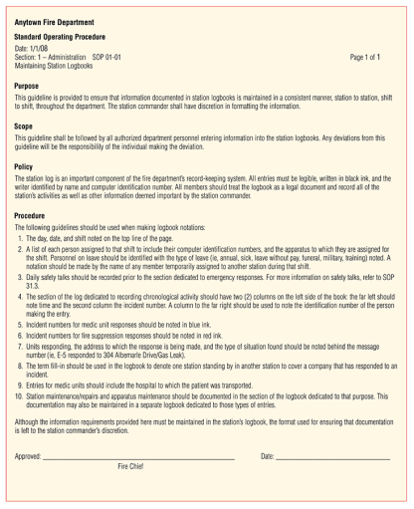
Fire Department Governance

Slide 29
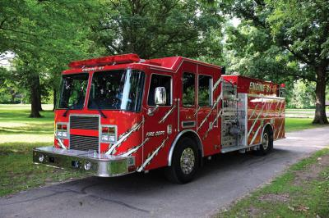
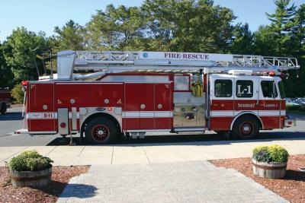
Company Types
Engine
Truck
Notes:
29

Slide 30
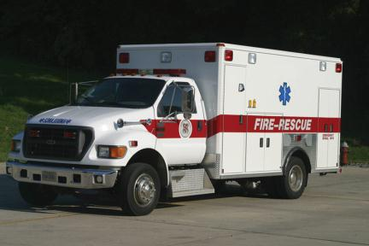
Company Types
Rescue
Wildland/brush
Hazardous materials
Emergency Medical Services (EMS)

Slide 31
Other Views of Fire Service Organization
Staffing
Department must have sufficient trained personnel available
Function
Bureau or office
Apparatus type
Geography

Slide 32
Chain of Command
Structure for managing the department and the fire-ground operations
Ranks may vary by department, but the concept is the same.

Slide 33
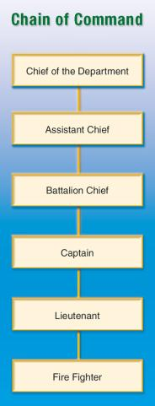
Chain of Command

Slide 34
Source of Authority
Source of authority
Local governments
Sometimes state and federal governments
Fire chief accountable to the governing body

Slide 35
Basic Principles of Organization
Discipline
Guiding and directing fire fighters
Division of labor
Makes individual responsible for completing the assigned task
Prevents duplicate job assignments

Slide 36
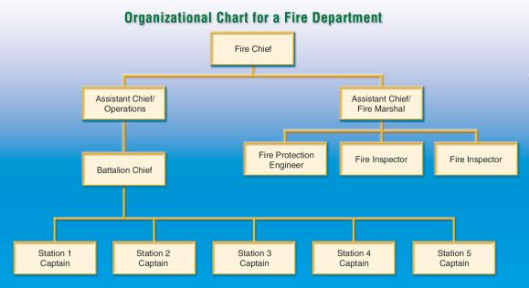
Basic Principles of Organization
Unity of command
Establishes a direct route of responsibility from the chief to the fire fighter

Slide 37
Basic Principles of Organization
Span of control
Number of people one person can supervise effectively

Slide 38
History of the Fire Service
Romans created first fire department, the Familia Publica.
First paid department in the United States was Boston (established in 1679).
Ben Franklin started the first volunteer department in the United States in Philadelphia in 1735.

Slide 39
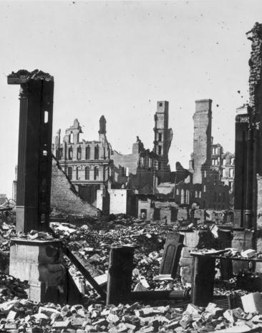
The Great Chicago Fire
Began October 8, 1871
Burned for 3 days
Damage totals:
$200 million
300 dead
90,000 homeless
Notes:
39

Slide 40
The Peshtigo Fire
Flash forest fire occurred at same time as the Great Chicago Fire
“Tornado of fire” 1000 ft high and 5 miles wide
2400 square miles (m²) of forest land burned
2200 dead
Several small communities destroyed

Slide 41
Building Codes
History of building codes
Egyptians used codes to prevent collapse.
Colonial communities had few codes.
Present codes address construction materials and “built-in” protection.

Slide 42
Building Codes
Codes are written by national organizations.
National Fire Protection Association (NFPA)
Volunteer committees research and develop proposals.
The consensus document is presented to the public.

Slide 43
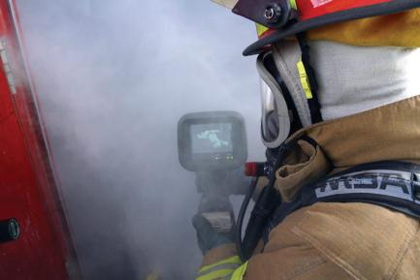
Training and Education
Today’s fire fighters operate high-tech, costly equipment.
Fire fighters need to continually sharpen their skills and increase their knowledge.

Slide 44
Fire Equipment
Colonial fire fighters had buckets, ladders, and fire hooks.
Hand-powered pumpers were developed in 1720.
Steam-powered pumpers were developed in 1829.

Slide 45
Fire Equipment
Present-day equipment
Single apparatus used for several purposes
Fire hydrants developed in 1817
First public call boxes developed in 1860

Slide 46
Communications
Fire wardens and night watchmen used during colonial period
Telegraph alarm systems developed in late 1800s
Present day
Hardwired and cellular telephones
Computer-aided dispatch facilities

Slide 47
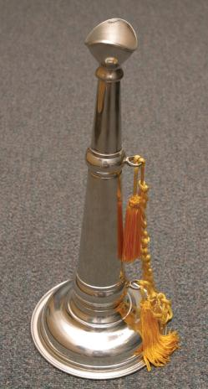
Communications
Fire-ground communications
Early days: Chief’s trumpet, now a symbol of authority
Present: Two-way radios

Slide 48
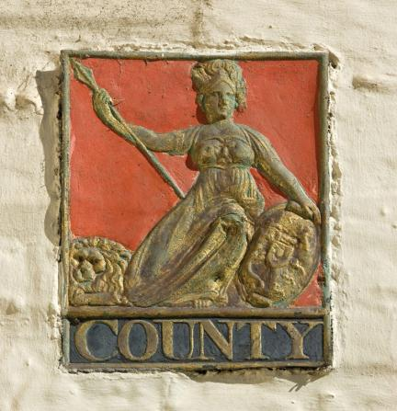
Paying for Fire Service
In early times, insurance companies paid fire departments for service.
Career departments are generally funded through local tax funds.
Notes:
48

Slide 49
Fire Service in the United States Today
About 1.1 million fire fighters
75% of career fire fighters serve communities of 25,000 or larger.
Half of volunteers serve rural areas with populations of 2500 or smaller.
Approximately 30,000 fire departments

Slide 50
Summary
Be safe, follow orders, work as a team, think, and follow the Golden Rule.
Training and performance qualifications for fire fighters are specified in NFPA 1001.
Fire Fighter I works under direct supervision; Fire Fighter II works under general supervision.

Slide 51
Summary
You may assume several roles in the fire department.
Most large fire departments have teams of specialized fire fighters.
When multiple agencies work together at an incident, a unified command must be established.

Slide 52
Summary
Governance is the process by which an organization exercises authority.
A fire department includes many different types of companies.
The chain of command is fire fighter, lieutenant, captain, battalion chief, assistant or division chief, and chief of the department.

Slide 53
Summary
The management principles of the fire service are discipline, division of labor, unity of command, and span of control.
Building codes govern construction materials.
It is helpful to study the past and present fire service.

