Slide 1
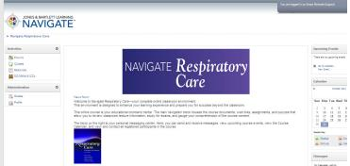

Jones & Bartlett Learning eLearning Solutions
Navigate Course Manager:
Respiratory Care, Principles and Practice

Slide 2



Learning Management System

Slide 3
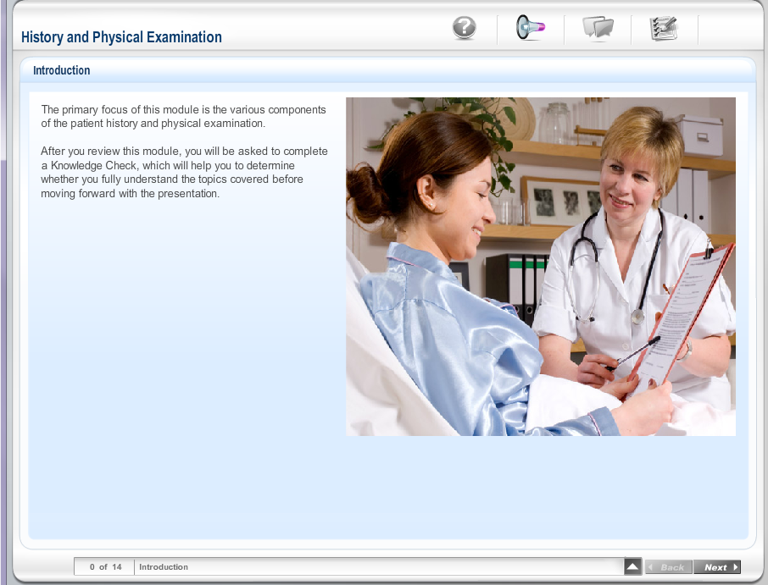
Interactive Audio-Based Lectures

Slide 4
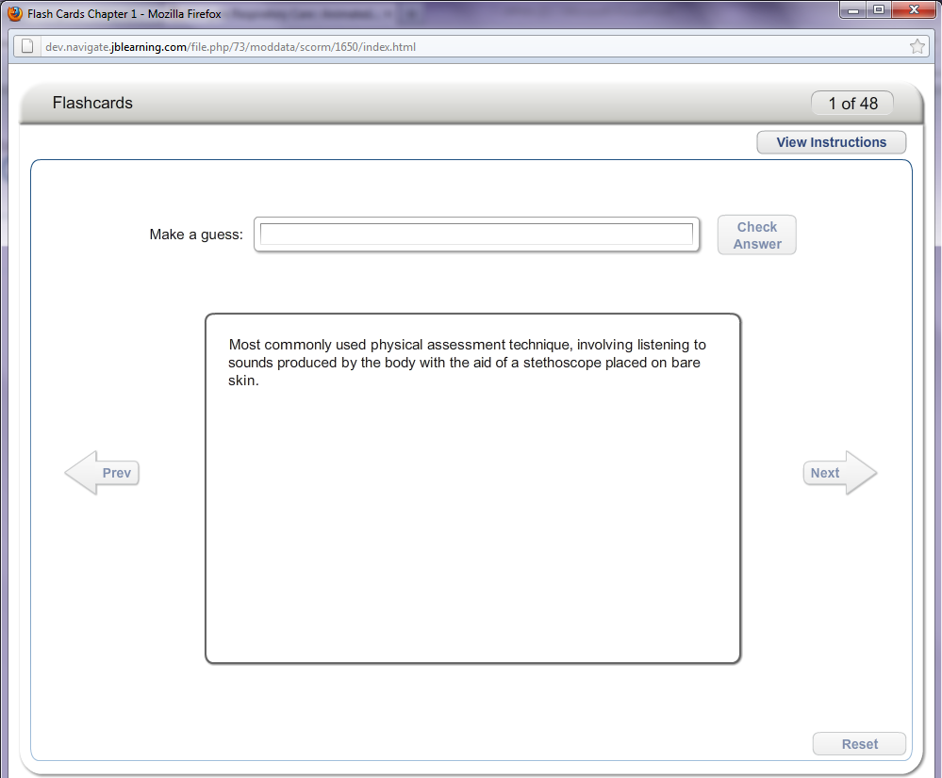
Animated Flashcards

Slide 5
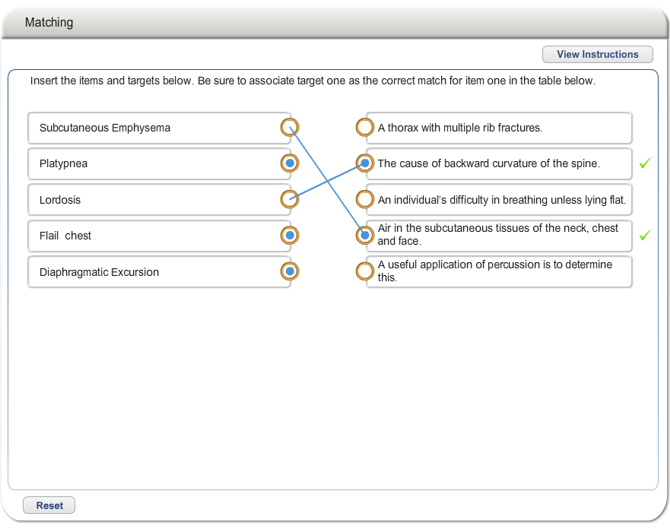
“Matching” Knowledge Checks

Slide 6
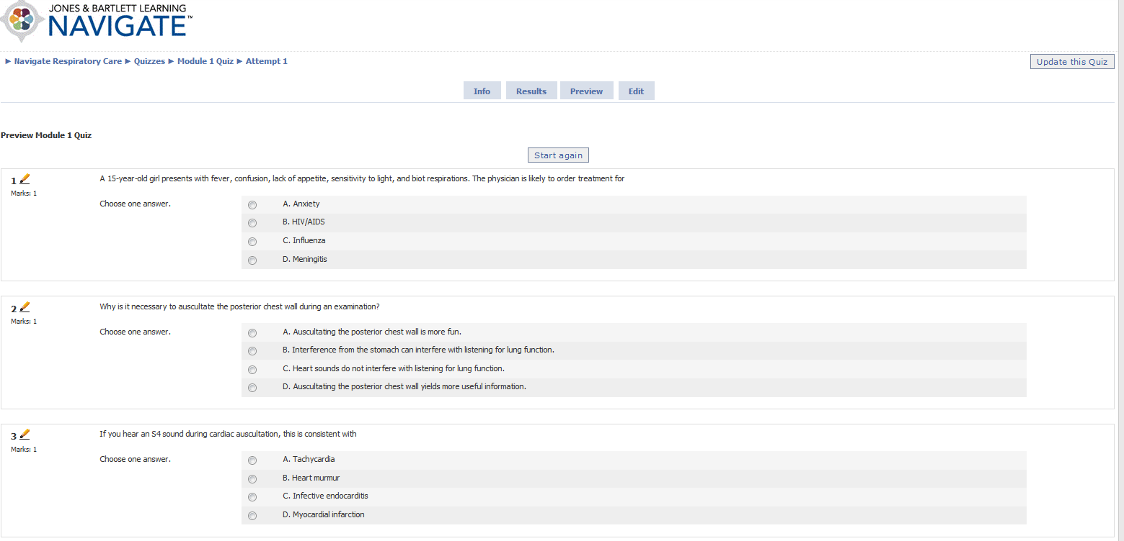
Pre-built Quizzes

Slide 7
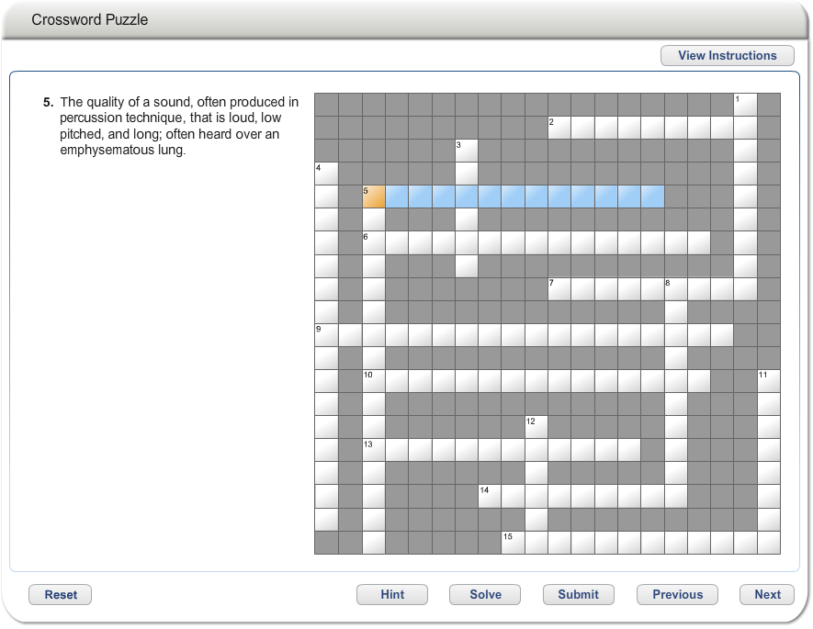
Crossword Puzzles

Slide 8
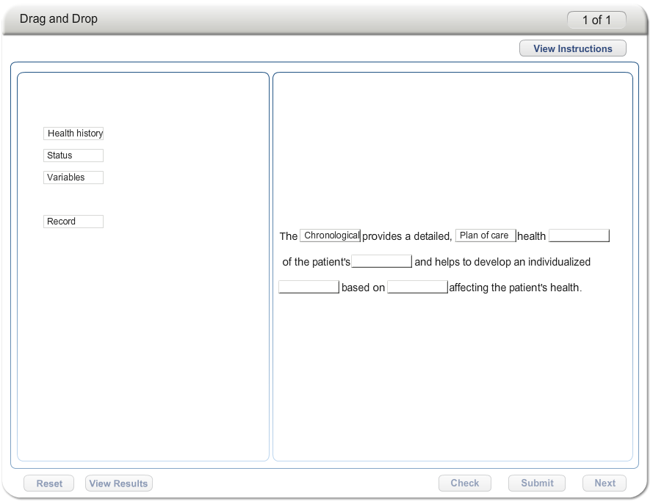
Drag and Drop Practice Activities

Slide 9
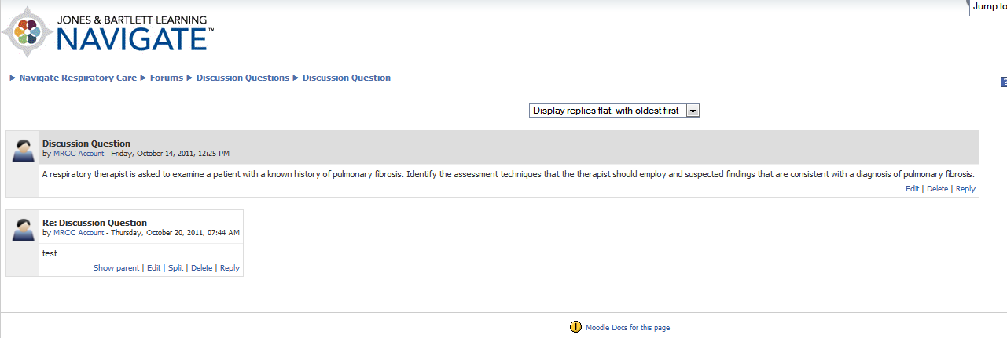
Pre-loaded Classroom
Discussion Questions

Slide 10




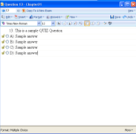


“Virtual Classroom” Prebuilt For You

Slide 11
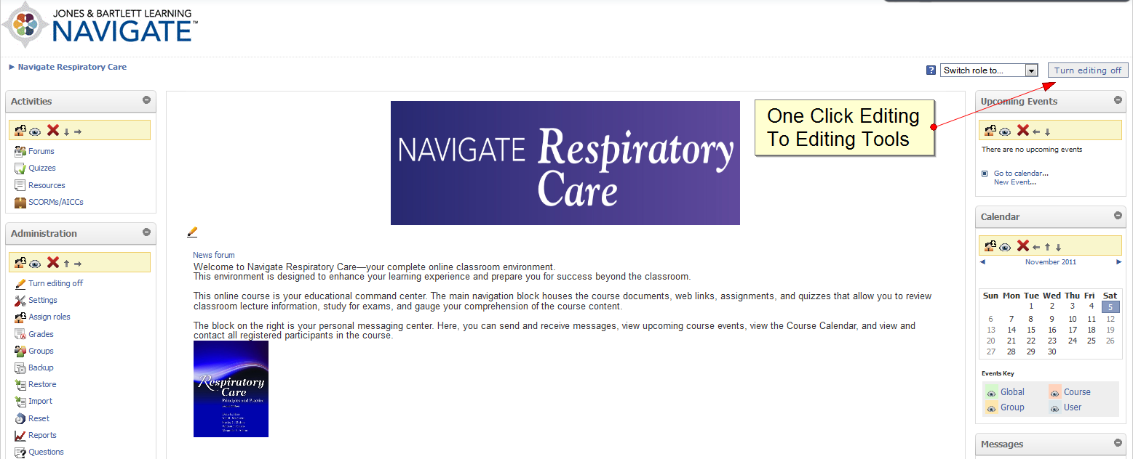
Easy Access to Editing
Notes:
PRESENTER: Gabi

Slide 12
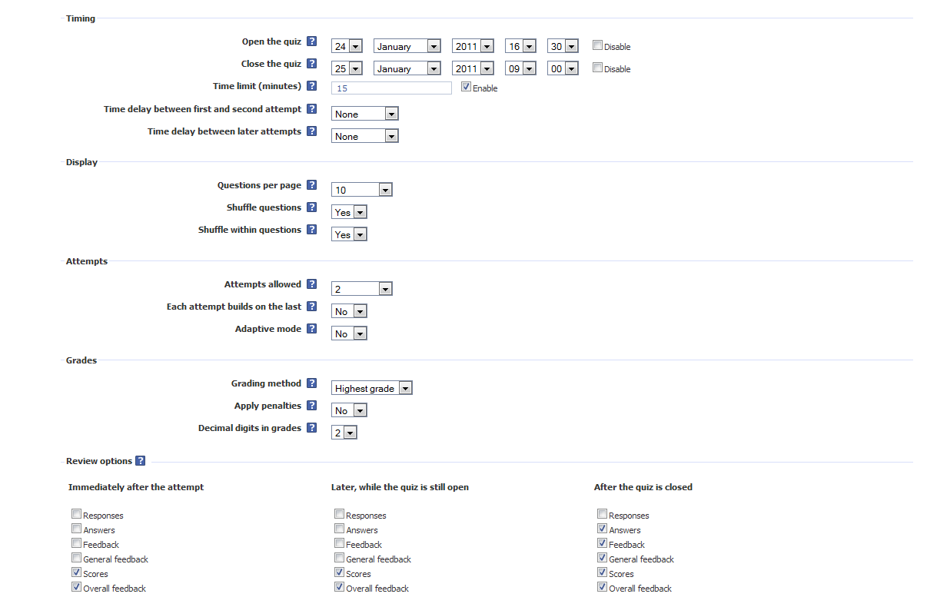
You Control Quiz Settings

Slide 13
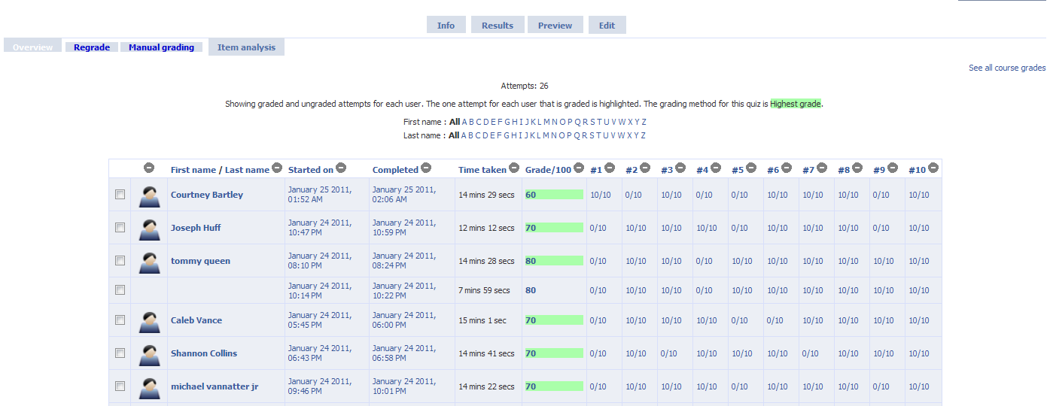
Detailed Quiz Reports

Slide 14
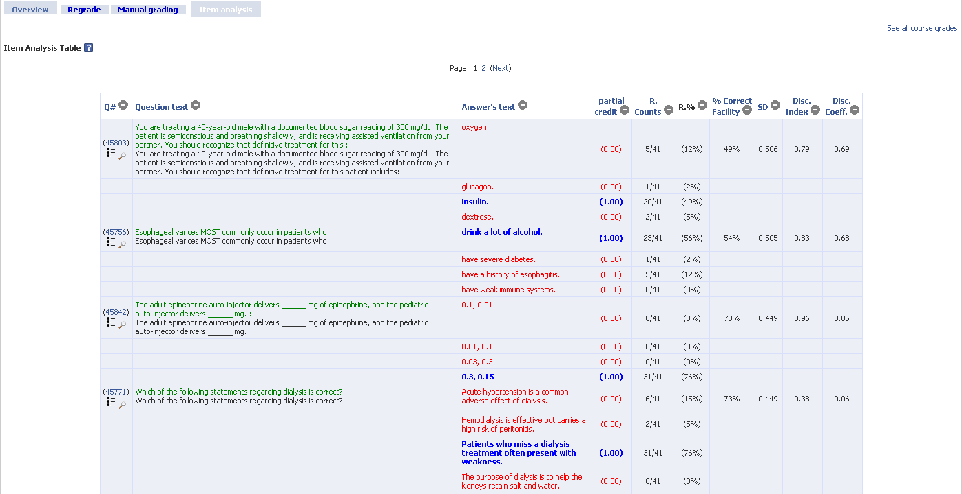
Item Analysis on Quiz Questions

Slide 15
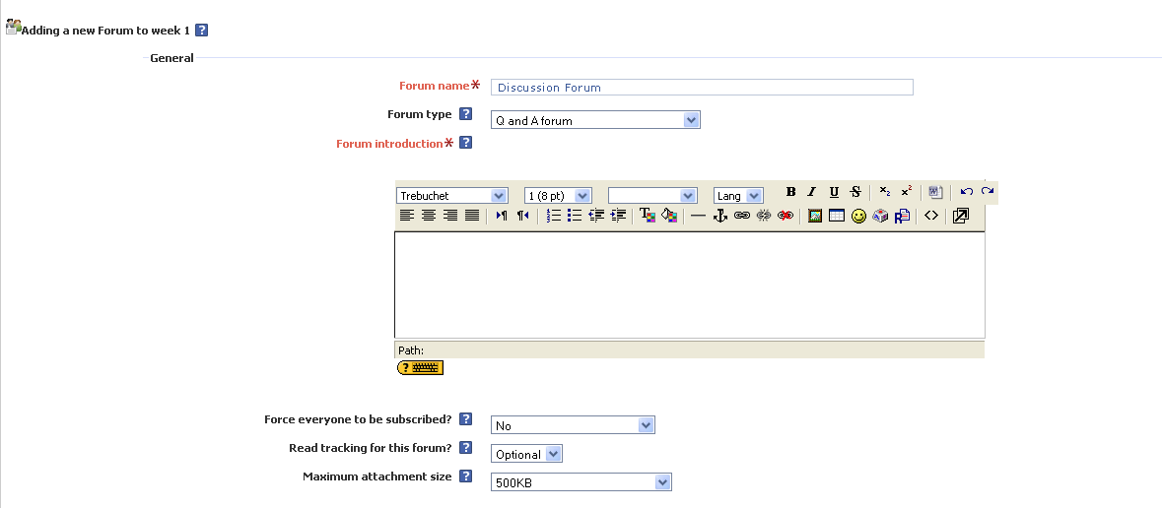
Full Control over Discussion Forums

Slide 16
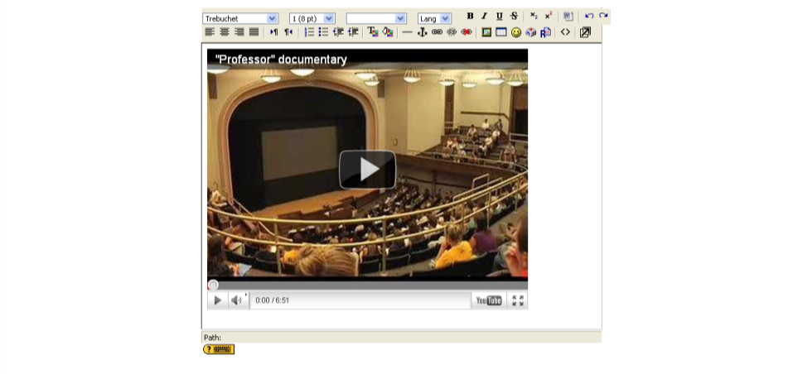
Easy to Upload
Additional Content

Slide 17
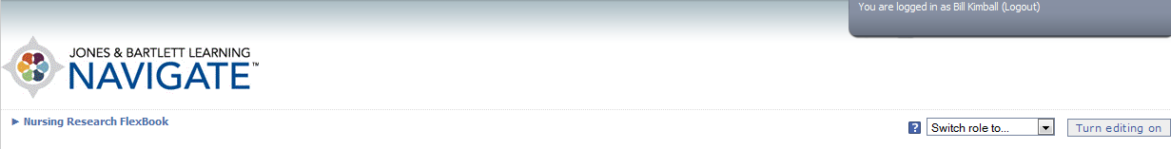
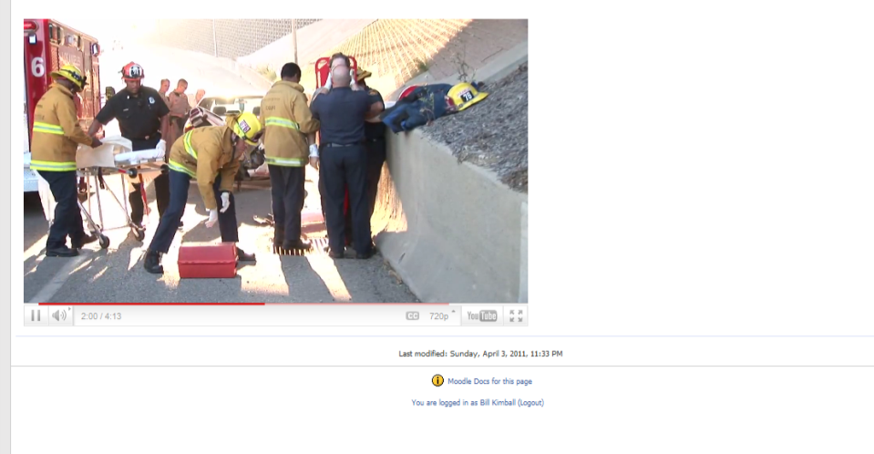
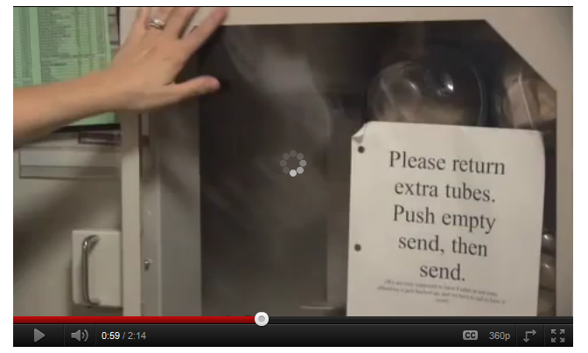
Easily Embed Video

Slide 18
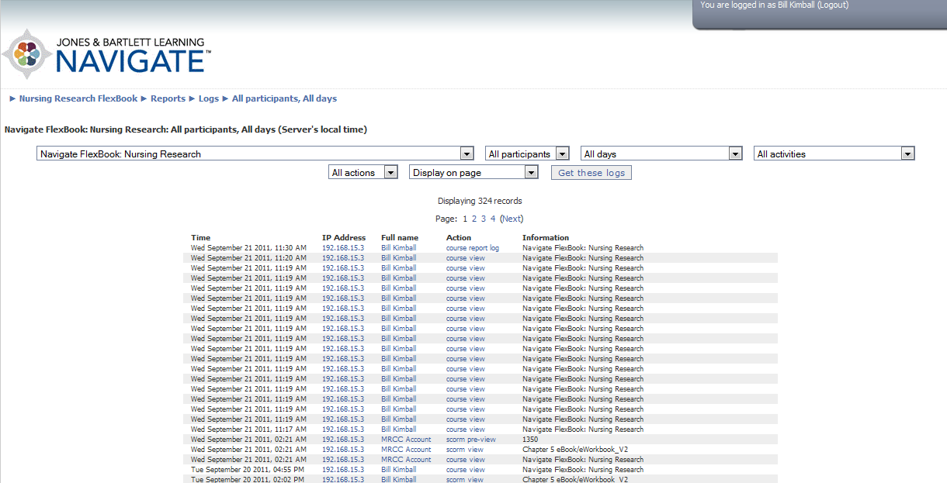
Detailed (and exportable!) Activity Reports

Slide 19

Companion Website

Slide 20
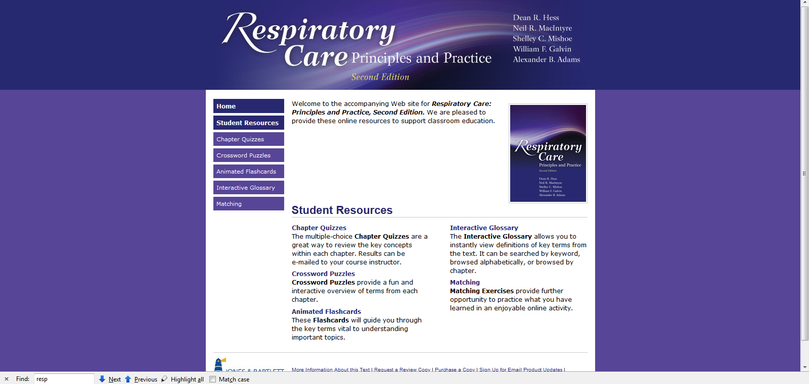
Companion Site Resources

Slide 21
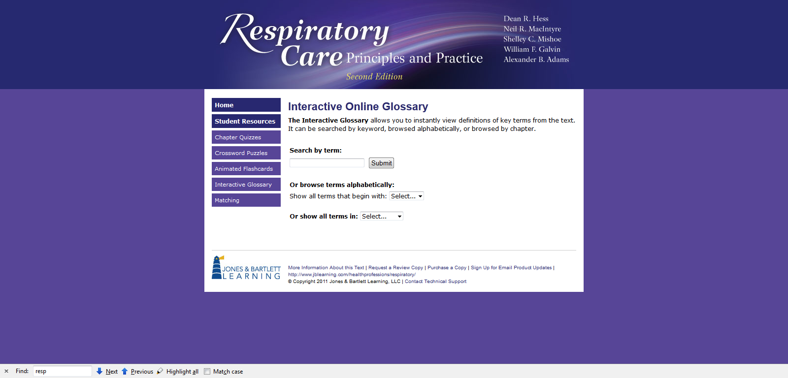
Companion Site
Interactive Glossary

Slide 22
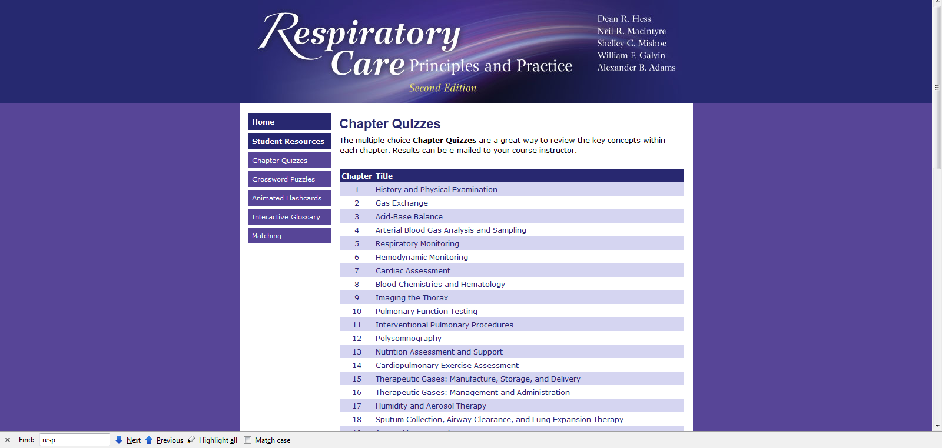
Companion Site
Chapter (“Practice”) Quizzes

Slide 23

Technical Customer Support Services

Slide 24

Support Services
Technical Support
Available via web, phone, or instant messenger
U.S. Based Support
Support for Students & Instructors is FREE

Slide 25

Support Services
Pre/Post Adoption Integration
Skilled technicians facilitate content integration
JBL will work with institutional IT teams to ensure smooth deployment

Slide 26

Support Services
Post Adoption Training
“Train-the-Trainer” sessions on demand
Complete systems training available, live, via the web

Slide 27
Ordering Information
1. Purchase the textbook, Respiratory Care Principles and Practice, Second Edition AND the online access code for Navigate Course Manager: Respiratory Care, Principles and Practice
- Textbook and Online ISBN-13: 978-1-4496-5559-4
2. Purchase the textbook, Respiratory Care Principles and Practice, Second Edition
- Textbook ISBN-13: 978-0-7637-6003-8
- eBook available at CourseSmart.com
3. Purchase the online access code for Navigate Course Manager: Respiratory Care, Principles and Practice
- Online Only ISBN-13: 978-1-4496-3419-3
To order, or request a demonstration: Visit http://go.jblearning.com/NavigateRC, contact your Account Specialist , or call 1-800-832-0034.

