Slide 2
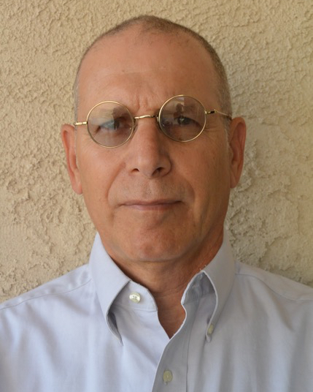
Richard Skolnik, MPA
Lecturer at the Yale School of Public Health and the Yale School of Management
Former Director for Health and Education (South Asia Region) at the World Bank
Vice President for International Programs at PRB
Director of the Center for Global Health at The George Washington University
Executive Director of the Harvard PEPFAR program

Slide 3
Webinar Objectives
By the time you finish this webinar, you should have gained additional familiarity with:
The goals of advising students on global health careers
Key questions students need to answer to prepare for and seek such careers
How to help students get answers to those questions
Key resources for you and students on global health careers
How peers approach advising on careers in global health

Slide 4
My Own Perspectives/Biases (Which does not make them right!)
Development and global health practitioner for 40 years
Managed a large multi-national and multi-cultural group and did lots of mentoring and hiring
13 years of teaching global health
Saw about 150 students a semester for 30 minutes each on global health careers
Regular participant in career sessions, such as Unite for Sight

Slide 5
What Students Don’t Know
How to think systematically about careers
How to “start at the end” and “work backwards”
How to think about the knowledge, skills, and experience they need
The best route to gain the above
The importance of mentors

Slide 6
What Do Students Want to Know?
Do you have to be a physician/clinician to work in global health?
Is it ethical to work in global health?
What jobs are there in global health?
What do I need to do to prepare for those jobs?
How do I get those jobs when I am “ready?”

Slide 7
Preparing to Meet Students
Résumé
Five lines on what they want us to say about them in 15 years
Five lines on who they want to be like
Three most important questions on which they want advice
Read on careers
Prepare for a 15 minute conversation – even if I give them 30 minutes

Slide 8
At the Meeting… Help Them To:
See the range of global health careers
See that you don’t need to be a physician/clinician
Think systematically about careers
Make “what they want to study in grad school” the dependent variable
Seek mentors, mentors, and mentors
Identify “role models”

Slide 9
At the Meeting 2... Point Them To:
Resources on global health careers
Career services – if they can be helpful
Former students
The importance of humility and ethical behaviors
General and specific opportunities

Slide 10
Selected Areas of Global Health Work
Research
Policy
Program Design and Implementation
Program Evaluation
Advocacy

Slide 11
Selected Functional Areas of Global Health Work

Slide 12
Types of Global Health Organizations
National, state and local governments
NGOs
Humanitarian organizations
Bilateral “AID” organizations
UN agencies and multilateral organizations
Public-private partnerships
Consulting firms
Foundations
Academia
Policy and Advocacy organizations

Slide 13
Selected Resources on Global Health Careers
Chapters 18 and 19 of Global Health 101, Third Edition
Greg Martin’s YouTube channel – Global Health with Greg Martin
Unite for Sight seminars and their annual conference

Slide 14
Selected Resources on Global Health Jobs
DEVEX
Global Health Council
GlobalHealthHub.org
International Jobs Center
Idealist.org
Zebra Jobs
Childsurvival.net
US CDC
PH Employment Connection
PH Career Mart
Akili Initiative
Eldis

Slide 15
Questions?
Press *1 to voice your question
Or use the chat box feature, to type your question

Slide 16
Global Health 101, Third Edition
Visit www.globalhealth101.com to:
Request complimentary review copies
Download sample chapters
Request access to instructor materials.
Global Health 101, 3rd Edition includes Navigate 2 Advantage Access with eBook, activities and exercises, links to videos, and pre-loaded assessments.

Slide 17
Thank you for participating!
Sophie Teague
steague@jblearning.com
Richard Skolnik, MPA
rskolnik@verizon.net
Recorded Webinar Will Be Posted on the LinkedIn Faculty Group:
http://go.jblearning.com/PHLinkedIn

