Slide 1
Thank you for joining us today to learn more about the new text:
Respiratory Care: Principles and Practice, Third Edition

Slide 2
Respiratory Care: Principles and Practice, 3e
Editors:
Dean R. Hess, PhD, RRT, FAARC
Neil R. MacIntyre, MD, FAARC
William F. Galvin, MSEd, RRT, CPFT, AE-C, FAARC
Shelley C. Mishoe, PhD, RRT, FAARC
ISBN: 978-1-284-05000-4
Hardcover · Includes Navigate 2 Advantage Access · Full-color
1520 pages | © 2016
List Price: $144.95*
JUST PUBLISHED!
*Suggested List Price. Price subject to change
Includes Navigate 2 with eBook!
Notes:
$144.95

Slide 3
Editors
Dean R. Hess, PhD, RRT, FAARC, Assistant Director of Respiratory Care, Massachusetts General Hospital, Associate Professor of Anesthesia, Harvard Medical School, Editor-in-Chief, RESPIRATORY CARE
Neil R. MacIntyre, MD, FAARC, Professor of Medicine and Medical Director of Respiratory Care Services, Duke University Medical Center
William F. Galvin, MSEd, RRT, CPFT, AE-C, FAARC, Assistant Professor, Frances M. Maguire School of Nursing and Health Professions, Director of Respiratory Care Program, Administrative and Teaching Faculty, TIPS Program, Gwynedd Mercy University
Shelley C. Mishoe, PhD, RRT, FAARC, Dean, College of Health Sciences and Professor, School of Community and Environmental Health, Old Dominion University

Slide 4
Key Content Coverage and Correlations
2015 NBRC Competencies
AARC Clinical Practice Guidelines
Patient Safety and Protocols
Ventilator Associated Events
Patient Education
Critical Thinking
Prevention of Re-admissions
Affordable Care Act

Slide 5
New to the Third Edition
NEW CHAPTERS
Extracorporeal Life Support for Respiratory Failure
Respiratory Anatomy
Respiratory Mechanics
Control of Breathing
Cardiovascular, Renal, and Neural Anatomy and Physiology
More user-friendly content specifically for the anatomy and physiology of respiratory, cardiac, renal, and neural systems.
Expanded, revised, and enhanced resources for students and instructors
More than 580 photos and illustrations, and more than 240 tables and equations

Slide 6
Chapter Features
Chapter Outline
Chapter Learning Objectives - correlated to the NBRC
Key Terms
Boxed Features
Respiratory Recap – review of key study points for core content
Stop and Think – provides an opportunity for critical thinking
Age-Specific Recaps - provides unique differences that are age specific—usually pediatric/neo-natal focused or geriatric
Case Studies
Equations
Clinical Practice Guidelines
Key Points
References

Slide 7
Table of Contents
SECTION I RESPIRATORY ASSESSMENT
Chapter 1 History and Physical Examination By Priscilla Simmons Chapter 2 Respiratory Monitoring by Dean R. Hess Chapter 3 Hemodynamic Monitoring By Dean R. Hess Chapter 4 Arterial Blood Gas Sampling, Analysis and Interpretation By Shelley C. Mishoe Chapter 5 Blood Chemistries and Hematology By Michal Senitko, Rajesh Bhagat, Neil R. MacIntyre Chapter 6 Cardiac Assessment By Jaspal Singh, William E. Downey Chapter 7 Imaging the Thorax By Dean R. Hess Chapter 8 Pulmonary Function Testing By Jeffrey Haynes Chapter 9 Interventional Pulmonary Procedures By Ellen Volker, Amy Treece, Momen M. Wahidi, Scott L. Shofer Chapter 10 Polysomnography By Bashir A. Chaudhary, Shelley C. Mishoe Chapter 11 Nutrition Assessment and Support By Mark S. Siobal Chapter 12 Cardiopulmonary Exercise Assessment By Neil R. MacIntyre
Notes:
Change slide to novel topics

Slide 8
Table of Contents
SECTION II RESPIRATORY THERAPEUTICS
Chapter 13 Therapeutic Gases: Manufacture, Storage, and Delivery By John Boatright and Jeffrey J. Ward Chapter 14 Therapeutic Gases: Management and Administration by John Boatright and Jeffrey J. Ward Chapter 15 Humidity and Aerosol Therapy By Dean R. Hess Chapter 16 Airway Clearance and Lung Expansion Therapy Dean R. Hess Chapter 17 Airway Management By John D. Davies, Alexander S. Niven, Dean R. Hess Chapter 18 Cardiopulmonary Resuscitation By Rhonda Bevis, Christine J. Moore Chapter 19 Mechanical Ventilators: Classification and Principles of Operation By Robert L. Chatburn and Teresa A. Volsko Chapter 20 Mechanical Ventilation By Dean R. Hess and Neil R. MacIntyre Chapter 21 Noninvasive Ventilation and Continuous Positive Airway Pressure By Dean R. Hess Chapter 22 Neonatal and Pediatric Respiratory Care By Melissa K. Brown Chapter 23 Extracorporeal Life Support for Respiratory Failure By Kyle J. Rehder and David A. Turner Chapter 24 Pulmonary Rehabilitation by Neil R. MacIntyre and Rebecca Crouch Chapter 25 Home Respiratory Care By Angela King and Robert McCoy Chapter 26 Disaster Management By Richard D. Branson and Dario Rodriquez Jr. Chapter 27 Respiratory Care of the Elderly By Helen M. Sorenson and William F. Galvin Chapter 28 Patient Safety ByThomas Malinowski
Notes:
Change slide to novel topics

Slide 9
Table of Contents
SECTION III: RESPIRATORY DISEASES
Chapter 29 Principles of Disease Management By William F. Galvin Chapter 30 Patient Education By William F. Galvin Chapter 31 Infection Control Principles By Donna D. Gardner Chapter 32 Asthma By Timothy R. Myers and Timothy Op’t Holt Chapter 33 Chronic Obstructive Pulmonary Disease By Puja Kohli Chapter 34 Interstitial Lung Disease By Kathy A. Short and Andrew J. Ghio Chapter 35 Pulmonary Vascular Disease By Charles William Hargett Chapter 36 Pneumonia By Bryan D. Kraft, Nicholas Wysham, and Morgan Mullaney Chapter 37 Cystic Fibrosis By Teresa A. Volsko, Catherine O’Malley, and Bruce K. Rubin Chapter 38 Acute Respiratory Distress Syndrome By Craig R. Rackley, Christopher E. Cox, and Michael A. Gentile Chapter 39 Postoperative Respiratory Care By Mark Simmons and Priscilla Simmons Chapter 40 Cardiac Failure By John C. Williams and William S. Stigler Chapter 41 Trauma By Bryce R. H. Robinson and Richard D. Branson Chapter 42 Burn and Inhalation Injury By Daniel F. Fisher Chapter 43 Neuromuscular Dysfunction By Francis C. Cordova, John Mullarkey, and Gerard J. Criner Chapter 44 Sleep-Disordered Breathing By Bashir A. Chaudhary, Arthur Taft, and Shelley C. Mishoe Chapter 45 Lung Cancer By Maha Farhat and Laura Brenner Chapter 46 Neonatal and Pediatric Respiratory Disorders By Sherry L. Barnhart
Notes:
Change slide to novel topics

Slide 10
Table of Contents
SECTION IV: APPLIED SCIENCES FOR RESPIRATORY CARE
Chapter 47 Respiratory Anatomy By William F. Galvin Chapter 48 Ventilation and Oxygenation By William C. Pruitt Chapter 49 Respiratory Mechanics By Dean R. Hess Chapter 50 Control of Breathing By Shawna Strickland Chapter 51 Cardiovascular, Renal, and Neural Anatomy and Physiology By Georgianna Sergakis, Crystal Dunlevy, and Sarah Varekojis Chapter 52 Physical Principles By Dean R. Hess Chapter 53 Chemistry for Respiratory Care By Carl F. Haas, Allan G. Andrews, Andrew J. Weirauch Chapter 54 Respiratory Microbiology By Ruben D. Restrepo and Marcos I. Restrepo Chapter 55 Respiratory Drugs By Christopher D. Lyman
Notes:
Change slide to novel topics

Slide 11
Table of Contents
SECTION V: THE RESPIRATORY CARE PROFESSION
Chapter 56 History of the Respiratory Care Profession By Jeffrey J. Ward Chapter 57 Professional Organizations By Lynda T. Goodfellow Chapter 58 Ethics of Health Care Delivery By Douglas E. Masini Chapter 59 Healthcare Economics By Garry J. Kauffman and William F. Galvin Chapter 60 Respiratory Care Research and Evidence-Based Practice By Dean R. Hess
Notes:
Change slide to novel topics

Slide 12
Pedagogical Elements
Outline
Learning Objectives
Key Terms with Definitions
Introduction
Boxed Features
Respiratory Recap – review of key study points for core content
Stop and Think – provides an opportunity for critical thinking
Age-Specific Recaps - provides unique differences that are age specific—usually pediatric/neo-natal focused or geriatric
Equations
Clinical Practice Guidelines
Case Studies
Key Points
References
Glossary
Index

Slide 13
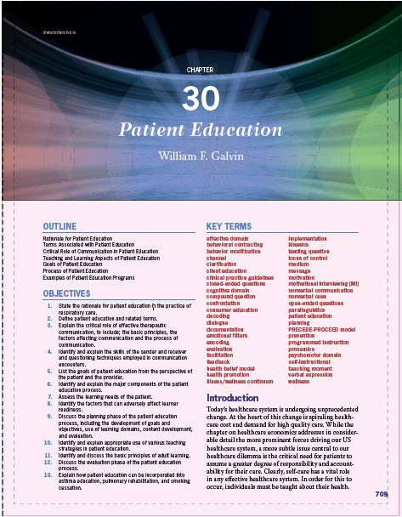
Pedagogical Elements
Outline
Learning Objectives
Key Terms with Definitions
Introduction

Slide 14
Pedagogical Elements
Boxed Features
Respiratory Recap – review of key study points for core content

Slide 15
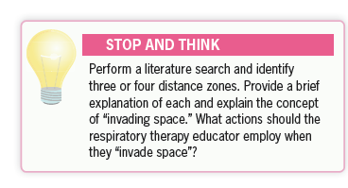
Pedagogical Elements
Boxed Features
Stop and Think – provides an opportunity for critical thinking
Insert chapter examples here

Slide 16
Pedagogical Elements
Boxed Features
Age-Specific Recaps - provides unique differences that are age specific—usually pediatric/neo-natal focused or geriatric

Slide 17
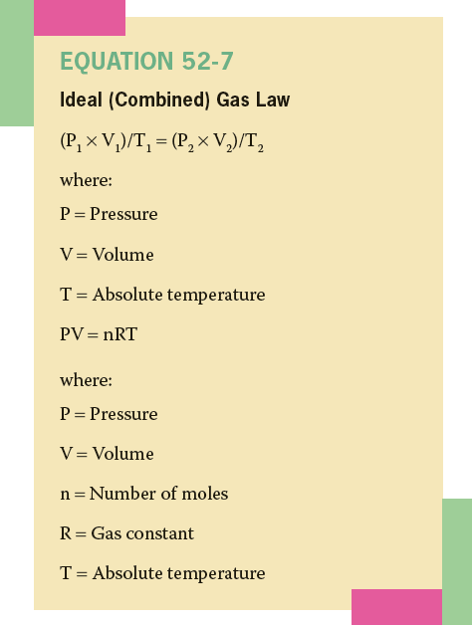
Pedagogical
Elements
Equations

Slide 18
Pedagogical Elements
Clinical
Practice
Guideline

Slide 19
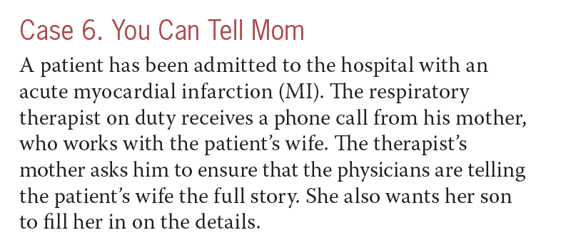
Pedagogical Elements
Case
Study

Slide 20
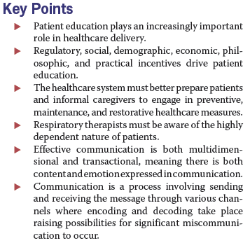
Pedagogical Elements
Key Points

Slide 21
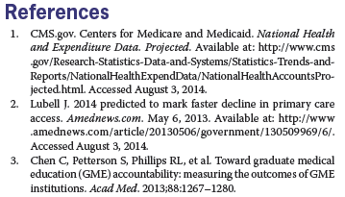
Pedagogical Elements
References

Slide 22
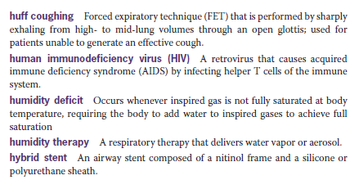
Pedagogical Elements
Glossary

Slide 23
Instructor Resources
Instructor's Manual
Transition Guide (2nd Edition to 3rd Edition)
Conversion Guide (from another text)
Sample Syllabus
Slides in PowerPoint format
Test Bank

Slide 24
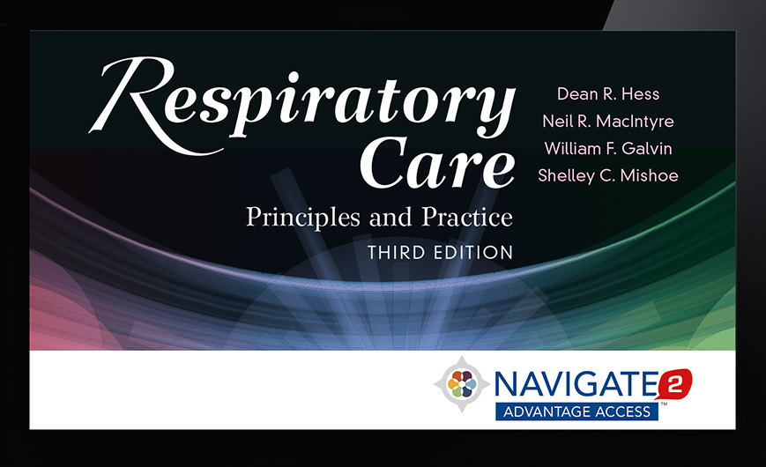
Navigate 2 Advantage Access
Whether you teach an online, hybrid, or traditional classroom-based course, Navigate 2 delivers unbeatable value. Navigate 2 provides access to mobile-ready course materials:
Learn: A complete eBook with interactive tools
Practice: A virtual Study Center with robust practice activities and flashcards
Assess: A homework and testing Assessment center with prepopulated quizzes and examinations
Analyze: A dashboard that reports actionable data
Complimentary access with each new textbook
Digital Only Option - Half the cost of the text/eBook package
ISBN: 978-1-4496-52180
$52.95* List Price
Available June 2015
*Suggested List Price. Price subject to change

Slide 25
Navigate 2 Advantage Access
eBook
Knowledge Checks
End-of-Chapter Quizzes
Study Tools
Learning Objectives
Case Studies
Key Image Review
Animations
Flashcards
Practice Activities
Chapter Overview Slides
Assessments
Lesson Quizzes (customizable)
Midterm Exam (customizable)
Final Exam (customizable)
Instructor Tools
Instructor's Manual
Transition Guide
Sample Syllabus
Slides in PowerPoint format
Test Bank
(Onboarding and Training provided)

Slide 26
Navigate 2 Homepage

Slide 27
eBook Sample View

Slide 28
Study Center

Slide 29
Knowledge Check Questions within eBook

Slide 30
Flashcards

Slide 31
Grade Book

Slide 32
Optional Bundle with Online Exam TestPrep
Navigate Preferred Access
Textbook, eBook, and online Exam TestPrep

Slide 33
Recap of Features
Includes updated content correlated to the 2015 NBRC exam matrices
Follows AARC Clinical Practice Guidelines
Written by over 75 expert contributors in the field of respiratory care, including clinicians and faculty from the top-ranking hospitals and schools in the U.S.
Provides accessible, student-friendly content supported by helpful pedagogical elements and online teaching and learning tools
More than 580 photos and illustrations, and more than 240 tables and equations
Textbook and eBook package - Each new print copy includes Navigate 2 Advantage Access that unlocks a complete eBook, Study Center, homework and Assessment Center, and a dashboard that reports actionable data.

Slide 34
Thank you for joining us today to learn more about Respiratory Care: Principles and Practice, Third Edition
We hope you will enjoy adding this fabulous resource to your Respiratory Care curriculum.

Slide 35
Questions?
If you would like to ask a question, our operator will assist with any requests.
Please press *1 on your telephone keypad to connect with the operator and submit your question, or feel free to type a question in the comment box to the right.

Slide 36
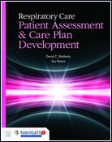
Additional Respiratory Care Resources http://go.jblearning.com/RC
Just Published
April 2015
Published Dec 2014
Published Dec 2014

Slide 37
Thank You!
Visit: http://go.jblearning.com/RCPP3e after 4/9/15 to view sample images, animations, watch the recorded webinar, download the webinar slides, and access more information.
For more information, now, visit: http://go.jblearning.com/Hess3e
Request a review copy
Instructor resources
Or request a review copy, instructor resources, or a Navigate 2 demo or training session by contacting your Health Professions Account Specialist via email: http://go.jblearning.com/findarep Or call 1-800-832-0034
Browse our website for additional resources: www.jblearning.com

