Slide 1
Navigate 2 Advantage Access for Manual Therapy of the Extremities

Slide 2
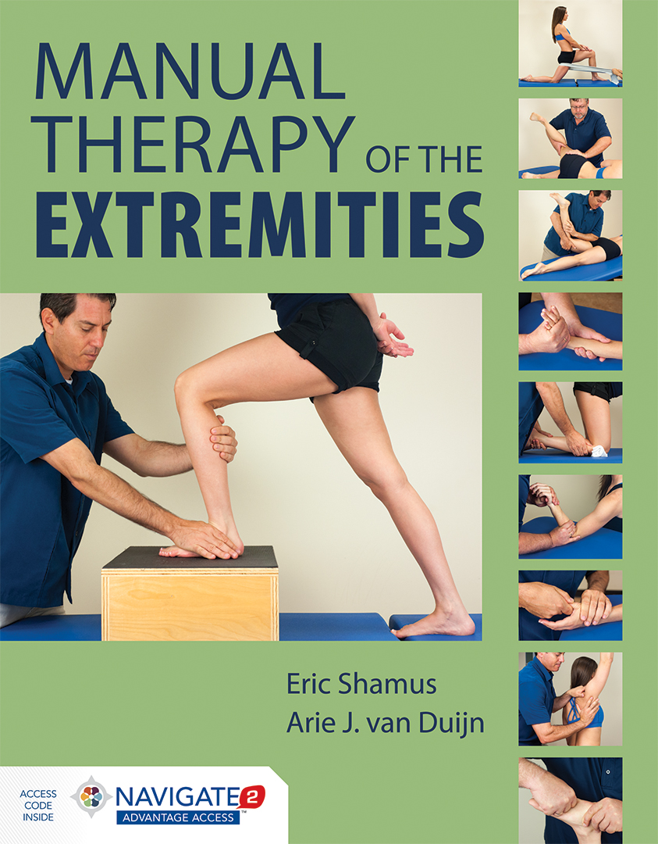
Manual Therapy of the Extremities
ISBN: 978-1-284-03670-1
Published: February 2016
Authors: Eric Shamus, PT, DPT, PhD Arie J. van Duijn, PT, EdD, OCS
List price: $99.95*
Spiral Paperback • 352 pages • © 2017
Includes Navigate 2 Advantage Access
* Current list price. Price is subject to change.

Slide 3
Navigate 2 Advantage Access
Digital Only
Online Access Code
ISBN: 978-1-284-08330-9
List price: $48.95*
© 2017
* Current list price. Price is subject to change.
(Half the cost of the textbook/eBook package)

Slide 4
Whether you teach an online, hybrid, or traditional classroom-based course, Navigate 2 delivers unbeatable value. Navigate 2 provides access to mobile-ready course materials:
Learn: A complete eBook with interactive tools and videos
Practice: A virtual Study Center with robust practice activities and flashcards
Assess: A homework and testing Assessment center with prepopulated quizzes and examinations
Analyze: A dashboard that reports actionable data

Slide 5
Navigate 2 Learning Management System
eBook
Embedded Videos
Knowledge Check Questions
End-of-Chapter Graded Quizzes
Study Tools
Learning Objectives
Flashcards
Practice Activities
Chapter Overview Presentation Slides in PowerPoint format
Interactive Glossary
Assessments
Chapter Quizzes
Midterm
Final
Instructor Tools
Preloaded Assignments
Automatic Grading
Student Reporting
Anatomical Labeling Exercises
Image Bank
Skills Checklist
Slides in PowerPoint format
Test Bank

Slide 6
Rob Howson
Jones & Bartlett Learning Education Technology Consultant

Slide 7
Training and Technical Support
On Demand Web based Training
U.S. Based Support (for students)
Education Technology Consultants team available (for instructors) at JBLSolutions@JBLearning.com
1-800-832-0034 option #5, Monday - Friday: 8:30am-8pm EST
http://www.jblearning.com/techsupport/

Slide 8
“Virtual Classroom Prebuilt For You”
Presentations in PowerPoint format
PDFs
Word Documents
Flashcards
Customize our content, or upload your own

Slide 9
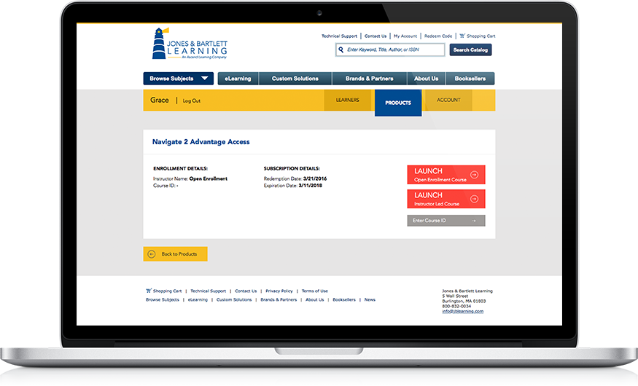
Included With Each Navigate 2 Textbook
Unique Access Code for each user
Access Code unlocks Digital Curriculum
Two Options:
Open Enrollment
Instructor Lead

Slide 10
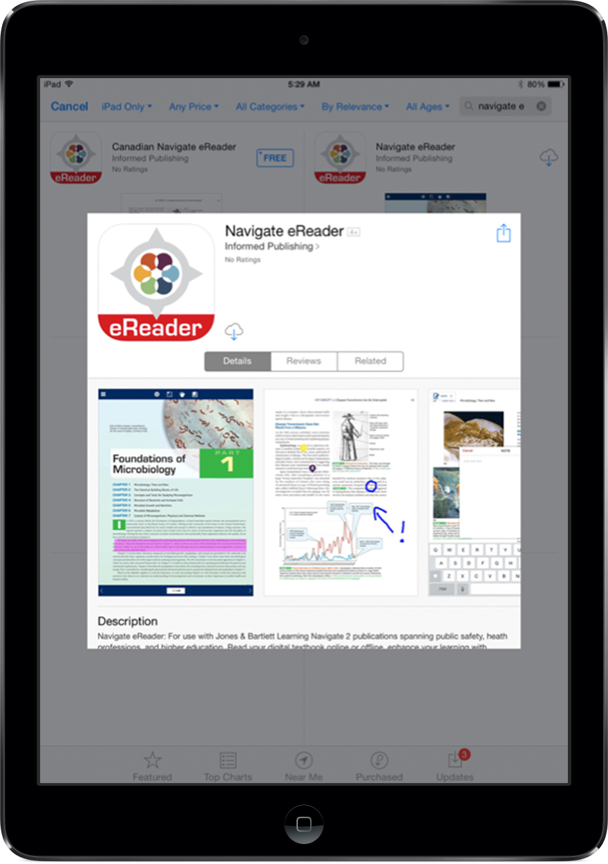
Mobile-Ready Course Materials
eBook
Read your digital textbook online or offline
Enhance learning with interactive tools
Make and share personal notes
Navigate eReader
Free app available via the Apple App Store or Google Play store

Slide 11
Live Demonstration
Let’s take a look at the Navigate 2 Advantage Access online tools for students and instructors.

Slide 12
Questions?
If you would like to ask a question, our operator will assist with any requests.
Please press *1 on your telephone keypad to connect with the operator and submit your question, or feel free to type a question in the comment box to the right.

Slide 13
Thank You!
For more information, visit: http://go.jblearning.com/Shamus – Be sure to watch the promo video!
To order, for more information, contact your Health Professions Account Specialist via email: http://go.jblearning.com/findarep or call 1-800-832-0034
Review copy requests
Instructor resources
Navigate 2 Trial Access
Adoption, Order, and Course Setup
Personalized Demonstration or Training Session
Browse our website for additional resources: www.jblearning.com

Slide 14
Thank you for joining us today, to learn more about:
Navigate 2 Advantage Access for Manual Therapy of The Extremities
We hope you will enjoy using this fabulous resource in your course.

